Slide 1
A Brief Introduction to Logic - Outline
Propositional Logic :Syntax
Propositional Logic :Semantics
Satisfiability and validity
Modeling with Propositional logic
Normal forms
Deductive proofs and resolution

Slide 2
Propositional logic
A proposition – a sentence that can be either true or false.
Propositions:
x is greater than y
Noam wrote this letter

Slide 3
Propositional logic: Syntax
The symbols of the language:
Propositional symbols (Prop): A, B, C,…
Connectives:
∧ and
∨ or
¬ not
→ implies
↔ equivalent to
© xor (different than)
⊥, > False, True
Parenthesis:(, ).

Slide 4
Propositional logic: Syntax
Q1: how many different binary symbols can we define ?
Q2: what is the minimal number of such symbols?

Slide 5
Formulas
Grammar of well-formed propositional formulas
Formula := prop | (¬Formula) | (Formula o Formula).
... where prop 2 Prop and o is one of the binary relations

Slide 6
Formulas
Examples of well-formed formulas:
(¬A)
(¬(¬A))
(A ∧ (B ∧ C))
(A→ (B→ C))
Correct expressions of Propositional Logic are full of unnecessary parenthesis.

Slide 7
Formulas
Abbreviations. We write
A o B o C o …
in place of
(A o (B o (C o …)))
Thus, we write
A ∧ B ∧ C, A→B→C, …
in place of
(A ∧ (B ∧ C)), (A→ (B→ C))

Slide 8
Formulas
We omit parenthesis whenever we may restore them through operator precedence:
¬ binds more strictly than ∧, ∨, and ∧, ∨ bind more strictly than →, ↔.
Thus, we write:
¬¬A for (¬(¬A)),
¬A ∧B for ((¬A ) ∧B)
A ∧B→ C for ((A∧B) → C), …

Slide 9
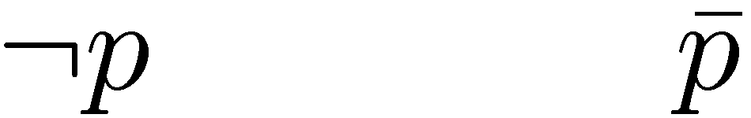

Alternative notations
Negation:
Conjunction:
Clauses:
Truth values: true/false 0/1

Slide 10
Propositional Logic: Semantics
Truth tables define the semantics (=meaning) of the operators
Convention: 0 = false, 1 = true
p ! q | p Ç q | p Æ q | q | p
1 | 0 | 0 | 0 | 0
1 | 1 | 0 | 1 | 0
0 | 1 | 0 | 0 | 1
1 | 1 | 1 | 1 | 1

Slide 11
Propositional Logic: Semantics
Truth tables define the semantics (=meaning) of the operators
p © q | p $ q | :p | q | p
0 | 1 | 1 | 0 | 0
1 | 0 | 1 | 1 | 0
1 | 0 | 0 | 0 | 1
0 | 1 | 0 | 1 | 1

Slide 12
Back to Q1
Q1: How many binary operators can we define that have different semantic definition ?
A: 16

Slide 13
Assignments
Definition: A truth-values assignment, α, is an element of 2^{Prop} (i.e., α ∈ 2^{Prop}).
In other words, ® is a subset of the variables that are assigned true.
Equivalently, we can see ® as a mapping from variables to truth values: α : Prop  {0,1}
Example: ®: {A  0, B  1,...}

Slide 14
Satisfaction relation (²): intuition
An assignment can either satisfy or not satisfy a given formula.
α ² φ means
“α satisfies φ” or
“α is a model of φ”
We will first see an example.
Then we will define these notions formally.

Slide 15
Example
Let Á = (A Ç (B → C))
Let ® = {A  0, B  0, C  1}
Q: Does ® satisfy Á?
(in symbols: does it hold that ® ² Á ? )
A: (0 Ç (0 → 1)) = (0 Ç 1) = 1
Hence, ® ² Á.
Let us now formalize an evaluation process.

Slide 16
The satisfaction relation (²): formalities
² is a relation:
² µ (2^{Prop} x Formula)
Examples:
({a}, a Ç b) // the assignment ® = {a} satisfies a Ç b
({a,b}, a Æ b)

Slide 17
The satisfaction relation (²): formalities
² is defined recursively:
α ² p if α (p) = true
α ² ¬φ if α 2 φ.
α ² φ₁ ∧ φ₂ if α ² φ₁ and α ² φ₂
α ² φ₁ ∨ φ₂ if α ² φ₁ or α ² φ₂
α ² φ₁ → φ₂ if α ² φ₁ implies α ² φ₂
α ² φ₁ ↔ φ₂ if α ² φ₁ iff α ² φ₂

Slide 18
From definition to an evaluation algorithm
Truth Evaluation Problem
Given φ ∈ Formula and α ∈ 2^{AP(φ)}, does α ² φ ?
Eval(φ, α){
If φ ≡ A, return α(A).
If φ ≡ (¬φ₁) return ¬Eval(φ₁, α))
If φ ≡ (φ₁ o φ₂) return Eval(φ₁, α) o Eval(φ₂, α)
}
Eval uses polynomial time

Slide 19
It doesn’t give us more than what we already know...
Recall our example
Let Á = (A Ç (B → C))
Let ® = {A  0, B  0, C  1}
Eval(Á,®) = Eval(A,α) Ç Eval(B → C,α) = 0 Ç Eval(B,α) → Eval(C,α) = 0 Ç (0 → 1) = 0 Ç 1 = 1
Hence, ® ² Á.

Slide 20
We can now extend the truth table to formulas
p Ç :q | (p Æ :p) | (p → (q → p)) | q | p
1 | 0 | 1 | 0 | 0
0 | 0 | 1 | 1 | 0
1 | 0 | 1 | 0 | 1
1 | 0 | 1 | 1 | 1

Slide 21
We can now extend the truth table to formulas
x₁
x₂
x₃
x₁ → (x₂ → :x₃)
0
0
0
1
0
0
1
1
0
1
0
1
0
1
1
1
1
0
0
1
1
0
1
1
1
1
0
1
1
1
1
0

Slide 22
Set of assignments
Intuition: a formula specifies a set of truth assignments.
Function models: Formula  2^{2Prop} (a formula  set of satisfying assignments)
Recursive definition:
models(A) = {α |α(A) = 1}, A ∈ Prop
models(¬φ₁) = 2^{Prop} – models(φ₁)
models(φ₁∧φ₂) = models(φ₁) ∩ models(φ₂)
models(φ₁∨φ₂) = models(φ₁) ∪ models(φ₂)
models(φ₁→φ₂) = (2^{Prop} – models(φ₁)) ∪ models(φ₂)

Slide 23
Example
models (A Ç B) = {{10},{01},{11}}
This is compatible with the recursive definition: models(A Ç B) = models(A) [ models (B) = {{10},{11}} [ {{01},{11}} = {{10},{01},{11}}

Slide 24
Theorem
Let φ ∈ Formula and α ∈ 2^{Prop}, then the following statements are equivalent:
1. α ² φ
2. α ∈ models(φ)

Slide 25
Only the projected assignment matters...
AP(φ) – the Atomic Propositions in φ.
Clearly AP(φ) µ Prop.
Let α₁, α₂ ∈ 2^{Prop}, φ ∈ Formula.
Lemma: if α₁|_{AP(φ)} = α₂|_{AP(φ)} , then
α₁² φ iff α₂ ² φ
Corollary: α ² φ iff α|_{AP(φ)} ² φ
We will assume, for simplicity, that Prop = AP(φ).
Projection

Slide 26
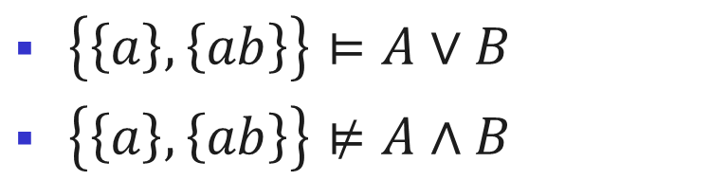
Extension of ² to sets of assignments
Let φ 2 Formula
Let T be a set of assignments, i.e., T ⊆ 2^{2Prop}
Definition. T ² φ if T ⊆ models(φ)
i.e., ² ⊆ 2^{2Prop} £ Formula
Examples:
$\left\{\left\{a\right\},\left\{ab\right\}\right\}⊨A∨B$
$\left\{\left\{a\right\},\left\{ab\right\}\right\}⊭A∧B$

Slide 27
Extension of ² to formulas
² ⊆ 2^{Formula} £ 2^{Formula}
Definition. Let Γ₁, Γ₂ be prop. formulas. Γ₁ ² Γ₂
iff models(Γ₁) ⊆ models(Γ₂)
iff for all α ∈ 2^{Prop}
if α ² Γ₁ then α ² Γ₂
Examples:
x₁ Æ x₂ ² x₁ Ç x₂
x₁ Æ x₂ ² x₂ Ç x₃

Slide 28
Semantic Classification of formulas
A formula φ is called valid if models(φ) = 2^{Prop}. (also called a tautology).
A formula φ is called satisfiable if models(φ) ≠ ;.
A formula φ is called unsatisfiable if models(φ) = ;. (also called a contradiction).
satisfiable
unsatisfiable
valid

Slide 29
Validity, satisfiability... in truth tables
p Ç :q | (p Æ :p) | (p → (q → q)) | q | p
1 | 0 | 1 | 0 | 0
0 | 0 | 1 | 1 | 0
1 | 0 | 1 | 0 | 1
1 | 0 | 1 | 1 | 1

Slide 30
Characteristics of valid/sat. formulas...
Lemma
A formula φ is valid iff ¬φ is unsatisfiable
φ is satisfiable iff ¬φ is not valid
yes
?
Satisfiability
checker
Is φ valid?
no

Slide 31
Look what we can do now...
We can write:
² Á when Á is valid
2 Á when Á is not valid
2 :Á when Á is satisfiable
² :Á when Á is unsatisfiable

Slide 32
Examples
(x₁ Æ x₂) → (x₁ Ç x₂) is
(x₁ Ç x₂) → x₁ is
(x₁ Æ x₂) Æ :x₁ is
valid
satisfiable
unsatisfiable

Slide 33
Time for equivalences
Here are some valid formulas:
² A Æ 1 $ A
² A Æ 0 $ 0
² ::A $ A // The double-negation rule
² A Æ (B Ç C) $ (A Æ B) Ç (A Æ C)
Some more (De-Morgan rules):
² :(A Æ B) $ (:A Ç :B)
² :(A Ç B) $ (:A Æ :B)

Slide 34
A minimal set of binary operators
Recall the question: what is the minimal set of operators necessary?
A: Through such equivalences all Boolean operators can be written with a single operator (NAND).
Indeed, typically industrial circuits only use one type of logical gate
We’ll see how two are enough: : and Æ
Or: ² (A Ç B) $ :(:A Æ :B)
Implies: ² (A → B) $ (:A Ç B)
Equivalence: ² (A $ B) $ (A → B) Æ (B → A)
...

Slide 35
The decision problem of formulas
The decision problem: Given a propositional formula Á, is Á satisfiable ?
An algorithm that always terminates with a correct answer to this problem is called a decision procedure for propositional logic.

Slide 36
A Brief Introduction to Logic - Outline
Propositional Logic :Syntax
Propositional Logic :Semantics
Satisfiability and validity
Modeling with Propositional logic
Normal forms
Deductive proofs and resolution

Slide 37
Before we solve this problem...
Q: Suppose we can solve the satisfiability problem... how can this help us?
A: There are numerous problems in the industry that are solved via the satisfiability problem of propositional logic
Logistics...
Planning...
Electronic Design Automation industry...
Cryptography...
... (every NP-P problem...)

Slide 38
Example 1: placement of wedding guests
Three chairs in a row: 1,2,3
We need to place Aunt, Sister and Father.
Constraints:
Aunt doesn’t want to sit near Father
Aunt doesn’t want to sit in the left chair
Sister doesn’t want to sit to the right of Father
Q: Can we satisfy these constraints?

Slide 39
Example 1 (cont’d)
Denote: Aunt = 1, Sister = 2, Father = 3
Introduce a propositional variable for each pair (person, place).
x_{ij} = person i is sited in place j, for 1 · i,j · 3
Constraints:
Aunt doesn’t want to sit near Father: ((x_{1,1} Ç x_{1,3}) → :x_{3,2}) Æ (x_{1,2} → (:x_{3,1} Æ :x_{3,3}))
Aunt doesn’t want to sit in the left chair :x_{1,1}
Sister doesn’t want to sit to the right of Father x_{3,1} → :x_{2,2} Æ x_{3,2} → :x_{2,3}

Slide 40
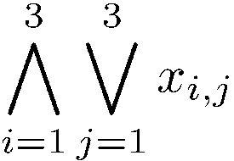
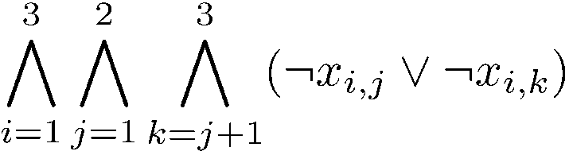
Example 1 (cont’d)
More constraints:
Each person is placed: (x_{1,1} Ç x_{1,2} Ç x_{1,3}) Æ (x_{2,1} Ç x_{2,2} Ç x_{2,3}) Æ (x_{3,1} Ç x_{3,2} Ç x_{3,3})
Or, more concisely:
No person is placed in more than one place:
Overall 9 variables, 26 conjoined constraints.

Slide 41
Example 2 (Lewis Carroll)
(1) All the dated letters in this room are written on blue paper; (2) None of them are in black ink, except those that are written in the third person; (3) I have not filed any of them that I can read; (4) None of them, that are written on one sheet, are undated; (5) All of them, that are not crossed, are in black ink; (6) All of them, written by Brown, begin with "Dear Sir"; (7) All of them, written on blue paper, are filed; (8) None of them, written on more than one sheet, are crossed; (9) None of them, that begins with "Dear Sir", are written in the third person. Therefore, I cannot read any of Brown’s letters.
Is this statement valid ?

Slide 42
Example 2 (cont’d)
p = “the letter is dated”
q = “the letter is written on blue paper”
(1) All the dated letters in this room are written on blue paper;
p ! q
r = “the letter is written in black ink”
s = “the letter is written in the third person”
(2) None of them are in black ink, except those that are written in the third person;
:s → :r
...

Slide 43
Example 3: assignment of frequencies
n radio stations
For each assign one of k transmission frequencies, k < n.
E -- set of pairs of stations, that are too close to have the same frequency.
Q: which graph problem does this remind you of ?

Slide 44
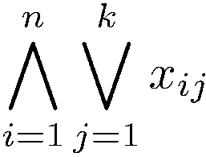
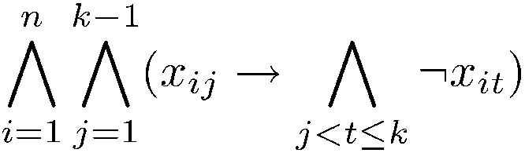
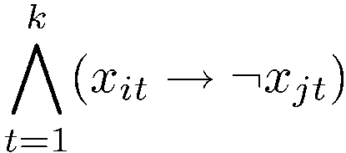
Example 3 (cont’d)
x_{i,j} – station i is assigned frequency j, for 1 · i · n, 1 · j · k.
Every station is assigned at least one frequency:
Every station is assigned not more than one frequency:
Close stations are not assigned the same frequency. For each (i,j) 2 E,

Slide 45
Two classes of algorithms for validity
Q: Is φ satisfiable (/:φ is valid) ?
Complexity: NP-Complete (the first-ever! – Cook’s theorem)
Two classes of algorithms for finding out:
Enumeration of possible solutions (Truth tables etc).
Deduction
More generally (beyond propositional logic):
Enumeration is possible only in some logics.
Deduction cannot necessarily be fully automated.

Slide 46
The satisfiability problem: enumeration
Given a formula φ, is φ satisfiable?
Boolean SAT(φ) {
B:=false
for all α ∈ 2^{AP(φ)}
B = B ∨ Eval(φ,α)
end
return B
}
There must be a better way to do that in practice.

Slide 47
A Brief Introduction to Logic - Outline
Brief historical notes on logic
Propositional Logic :Syntax
Propositional Logic :Semantics
Satisfiability and validity
Modeling with Propositional logic
Normal forms
Deductive proofs and resolution

Slide 48
Definitions…
Definition: A literal is either an atom or a negation of an atom.
Let φ = :(A Ç :B). Then:
Atoms: AP(φ) = {A,B}
Literals: lit(φ) = {A, :B}
Equivalent formulas can have different literals
φ = :(A Ç :B) = :A Æ B
Now lit(φ) = {:A, B}

Slide 49
Definitions…
Definition: a term is a conjunction of literals
Example: (A Æ :B Æ C)
Definition: a clause is a disjunction of literals
Example: (A Ç :B Ç C)

Slide 50
Negation Normal Form (NNF)
Definition: A formula is said to be in Negation Normal Form (NNF) if it only contains :, Æ and Ç connectives and only atoms can be negated.
Examples:
φ₁ = :(A Ç :B) is not in NNF
φ₂ = :A Æ B is in NNF

Slide 51
Converting to NNF
Every formula can be converted to NNF in linear time:
Eliminate all connectives other than Æ, Ç, :
Use De Morgan and double-negation rules to push negations to the right
Example: φ = :(A ! :B)
Eliminate ‘!’: φ = :(:A Ç :B)
Push negation using De Morgan: φ = (::A Æ ::B)
Use Double negation rule: φ = (A Æ B)

Slide 52
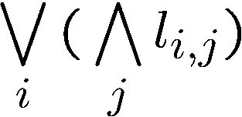
Disjunctive Normal Form (DNF)
Definition: A formula is said to be in Disjunctive Normal Form (DNF) if it is a disjunction of terms.
In other words, it is a formula of the form where l_{i,j} is the j-th literal in the i-th term.
Examples
φ = (A Æ :B Æ C) Ç (:A Æ D) Ç (B) is in DNF
DNF is a special case of NNF

Slide 53
Converting to DNF
Every formula can be converted to DNF in exponential time and space:
Convert to NNF
Distribute disjunctions following the rule: ² A Æ (B Ç C) $ ((A Æ B) Ç (A Æ C))
Example:
φ = (A Ç B) Æ (:C Ç D) = ((A Ç B) Æ (:C)) Ç ((A Ç B) Æ D) = (A Æ :C) Ç (B Æ :C) Ç (A Æ D) Ç (B Æ D)
Q: how many clauses would the DNF have had we started from a conjunction of n clauses ?

Slide 54
Satisfiability of DNF
Is the following DNF formula satisfiable?
(x₁ Æ x₂ Æ :x₁) Ç (x₂ Æ x₁) Ç (x₂ Æ :x₃ Æ x₃)
What is the complexity of satisfiability of DNF formulas?

Slide 55
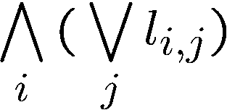
Conjunctive Normal Form (CNF)
Definition: A formula is said to be in Conjunctive Normal Form (CNF) if it is a conjunction of clauses.
In other words, it is a formula of the form where l_{i,j} is the j-th literal in the i-th term.
Examples
φ = (A Ç :B Ç C) Æ (:A Ç D) Æ (B) is in CNF
CNF is a special case of NNF

Slide 56
Converting to CNF
Every formula can be converted to CNF:
In exponential time and space with the same set of variables.
In linear time and space if new variables are added.
In this case the original and converted formulas are “equi-satisfiable”.
This technique is called Tseitin’s encoding.

Slide 57
Converting to CNF: the exponential way
CNF(φ) {
case
φ is a literal: return φ
φ is ψ₁ Æ ψ₂: return CNF(ψ₁) Æ CNF(ψ₂)
φ is ψ₁ Ç ψ₂: return Dist(CNF(ψ₁),CNF(ψ₂))
}
Dist(ψ₁,ψ₂) {
case
ψ₁ is φ₁₁ Æ φ₁₂: return Dist(φ₁₁,ψ₂) Æ Dist(ψ₁₂,ψ₂) ψ₂ is φ₂₁ Æ φ₂₂: return Dist(ψ₁,φ₂₁) Æ Dist(ψ₁,φ₂₂) else: return ψ₁ Ç ψ₂

Slide 58
Converting to CNF: the exponential way
Consider the formula φ = (x₁ Æ y₁) Ç (x₂ Æ y₂)
CNF(φ)= (x₁ Ç x₂) Æ (x₁ Ç y₂) Æ (y₁ Ç x₂) Æ (y₁ Ç y₂)
Now consider: φ_{n} = (x₁ Æ y₁) Ç (x₂ Æ y₂) Ç ☹ Ç (x_{n} Æ y_{n})
Q: How many clauses CNF(φ) returns ?
A: 2^{n}

Slide 59
Converting to CNF: Tseitin’s encoding
Consider the formula φ = (A ! (B Æ C))
The parse tree:
Associate a new auxiliary variable with each gate.
Add constraints that define these new variables.
Finally, enforce the root node.
!
a₁
A
Æ
a₂
B
C

Slide 60
Converting to CNF: Tseitin’s encoding
Need to satisfy:
(a₁ $ (A ! a₂)) Æ
(a₂ $ (B Æ C)) Æ
(a₁)
Each such constraint has a CNF representation with 3 or 4 clauses.
!
a₁
A
Æ
a₂
B
C

Slide 61
Converting to CNF: Tseitin’s encoding
Need to satisfy:
(a₁ $ (A ! a₂)) Æ
(a₂ $ (B Æ C)) Æ
(a₁)
First: (a₁ Ç A) Æ (a₁ Ç :a₂) Æ (:a₁ Ç :A Ç a₂)
Second: (:a₂ Ç B) Æ (:a₂ Ç C) Æ (a₂ Ç :B Ç :C)

Slide 62
Converting to CNF: Tseitin’s encoding
Let’s go back to φ_{n} = (x₁ Æ y₁) Ç (x₂ Æ y₂) Ç ☹ Ç (x_{n} Æ y_{n})
With Tseitin’s encoding we need:
2n auxiliary variables a₁,…,a_{2n}.
Each adds 3 constraints.
Top clause: (a₁ Ç ☹ Ç a_{n})
Hence, we have
6n + 1 clauses, instead of 2^{n}.
4n variables rather than 2n.

Slide 63
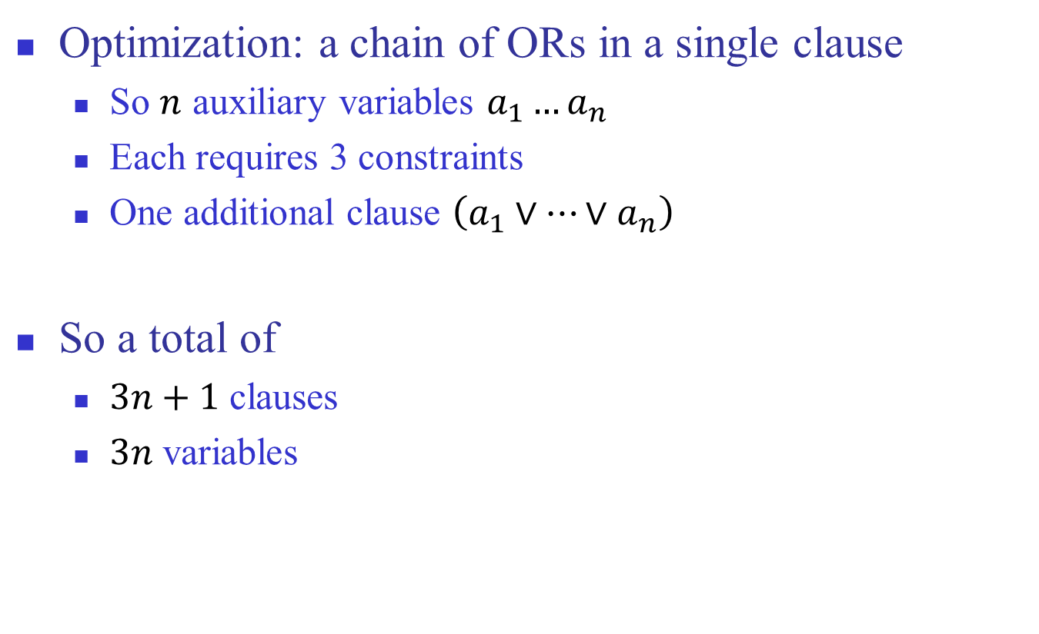
But we can do better…
Optimization: a chain of ORs in a single clause
So $n$ auxiliary variables $a_{1}…a_{n}$
Each requires 3 constraints
One additional clause $\left(a_{1}∨⋯∨a_{n}\right)$
So a total of
$3n+1$ clauses
$3n$ variables

Slide 64
What now?
Time to solve the decision problem for propositional logic.
The only algorithm we saw so far was building truth tables.

Slide 65
Two classes of algorithms for validity
Q: Is φ valid ?
Equivalently: is :φ satisfiable?
Two classes of algorithm for finding out:
Enumeration of possible solutions (Truth tables etc).
Deduction
In general (beyond propositional logic):
Enumeration is possible only in some theories.
Deduction typically cannot be fully automated.

Slide 66
The satisfiability Problem: enumeration
Given a formula φ, is φ satisfiable?
Boolean SAT(φ) {
B:=false
for all α ∈ 2^{AP(φ)}
B = B ∨ Eval(φ,α)
end
return B
}
NP-Complete (the first-ever! – Cook’s theorem)

Slide 67
A Brief Introduction to Logic - Outline
Brief historical notes on logic
Propositional Logic :Syntax
Propositional Logic :Semantics
Satisfiability and validity
Modeling with Propositional logic
Normal forms
Deductive proofs and resolution

Slide 68
Deduction requires axioms and Inference rules
Inference rules: Antecedents Consequent
Examples:
A ! B B ! C A ! C
A ! B A B
(rule-name)
(trans)
(M.P.)

Slide 69
Axioms
Axioms are inference rules with no antecedents, e.g.,
We can turn an inference rule into an axiom if we have ‘→’ in the logic.
So the difference between them is not sharp.
(H1)
A ! (B ! A)

Slide 70
Proofs
A proof uses a given set of inference rules and axioms.
This is called the proof system.
Let H be a proof system.
Γ `_{H} φ means: there is a proof of φ in system H whose premises are included in Γ
`_{H} is called the provability relation.

Slide 71
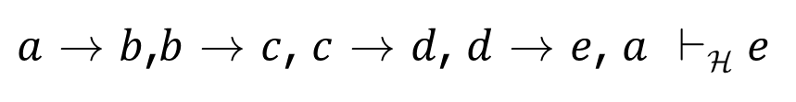
Example
Let H be the proof system comprised of the rules Trans and M.P. that we saw earlier.
Does the following relation holds?
$a$ ! $b$,$b$ ! $c$, $c$ ! $d$, $d$ ! $e$, $a$ `_{H} $e$

Slide 72
Deductive proof: example
a ! b, b ! c, c ! d, d ! e, a `_{H} e
1. a ! b premise
2. b ! c premise
3. a ! c 1,2,Trans
4. c ! d premise
5. d ! e premise
6. c ! e 4,5, Trans
7. a ! e 3,6, Trans
8. a premise
9. e 3,8.M.P.

Slide 73
Proof graph (DAG)
a ! b b ! c c ! d d ! e
(trans)
(trans)
a ! c
c ! e
(trans)
a
a ! e
(M.P.)
e
Roots: premises

Slide 74
Proofs
The problem: ` is a relation defined by syntactic transformations of the underlying proof system.
For a given proof system H,
does ` conclude “correct” conclusions from premises ?
Can we conclude all true statements with H?
Correct with respect to what ?
With respect to the semantic definition of the logic. In the case of propositional logic truth tables gives us this.

Slide 75
Soundness and completeness
Let H be a proof system
Soundness of H: if `_{H} φ then ² φ
Completeness of H : if ² φ then `_{H} φ
How to prove soundness and completeness ?

Slide 76
Example: Hilbert axiom system (H)
Let H be (M.P) + the following axiom schemas:
(H1)
A ! (B ! A)
(H2)
((A !(B ! C)) !((A! B)!(A! C))
(H3)
(:B ! :A) ! (A ! B)
H is sound and complete

Slide 77
Soundness and completeness
To prove soundness of H, prove the soundness of its axioms and inference rules (easy with truth-tables). For example:
Completeness – harder, but possible.
A ! (B ! A) | B | A
1 | 0 | 0
1 | 1 | 0
1 | 0 | 1
1 | 1 | 1

Slide 78
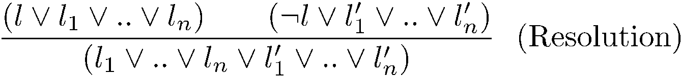
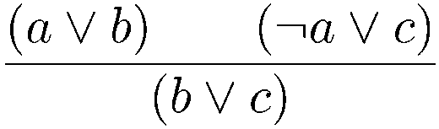
The resolution inference system
The resolution inference rule for CNF:
Example:

Slide 79
Proof by resolution
Let ϕ = (1 3) Æ (-1 2 5) Æ (-1 4) Æ (-1 -4) Æ (1 -2)
We’ll try to prove ϕ → (3 5)
(1 3)
(-1 2 5)
(2 3 5)
(1 -2)
(-1 4)
(-1 -4)
(1 3 5)
(-1)
(3 5)

Slide 80
Resolution
Resolution is a sound and complete inference system for CNF
If the input formula is unsatisfiable, there exists a proof of the empty clause

Slide 81
Example
Let ϕ = (1 3) Æ (-1 2) Æ (-1 4) Æ (-1 -4) Æ (1 -2) Æ (-3)
(1 3)
(-1 2)
(2 3)
(1 -2)
(-1 4)
(-1 -4)
(1 3)
(-1)
(3)
(-3)
()

Slide 82
Another system: Natural deduction (N)
A B
A Æ B
A Æ B
A
A Æ B
B
(Introduction-and) (I - Æ)
(Elimination-1-and) (E1 - Æ)
(Elimination-2-and) (E2 - Æ)

Slide 83
Example
Theorem: p Æ q, r `_{N} q Æ r
Note: the theorem only claims provability relation. Correctness is implied by the soundness of N.
Proof:
p Æ q premise
r premise
q E-2-Æ, 1
q Æ r I-and, 2,3

Slide 84
More rules for N
::A
A
A
::A
(E-double negation)
(I-double negation)

Slide 85
More rules for N
A A → B
B
Similar to another elimination rule:
:B A → B
:A
If assuming p allows to prove q then p → q (I – implication)
(E - implication)
(Modus-Tollens (M.T.))

Slide 86
Example
Theorem: p → q ` :q → :p
Proof:
p Æ q premise
:q assumption
:p M.T. 1,2
:q → :p I-implication
Note the difference between assumptions and premises. The former needs to be discharged.
The introduction-implication rule lets us discharge assumptions.

Slide 87
Example
Theorem: :q → :p ` p → ::q
Proof:
:q → :p premise
p assumption
::q M.T. 1,2
p → ::q I-implication

Slide 88
Example
Theorem: ` (q → r) → ((: q → : p) → (p → r))
Proof:
q → r assumption
:q → :p assumption
p assumption
:: p I-double-negation 3
:: q M.T., 2,4
q E-double-negation,5
r E-implication 1,6
p → r I-implication 3-7
(:q → :p) → (p → r) I-implication 2-8
(q → r) → ((:q → :p) → (p → r) I-implication 1-9

Slide 89
More rules...
A .
A Ç B
B .
A Ç B
(p Ç q) (p → r) (q → r)
r
(I-or1)
(I-or2)
(E-or)

Slide 90
Example
Theorem: p Ç q ` q Ç p
Proof:
p Ç q premise
p assumption
q Ç p I-or1
p → q Ç p I-implication
q assumption
q Ç p I-or2
q → q Ç p I-implication
q Ç p E-or

